Slide 1
Dr. Semmelweis and the discovery of handwashing
Below are the outcomes of the Data Analysis
Analyzed handwashing data from two hospitals to determine whether handwashing among doctors reduces the rate of death in women during childbirth
Utilized Python to analyze data and visualized data using i.e. Matplotlib library.
Performed bootstrap analysis of data to highlight that when doctors washed hands while delivering babies there was a 10% reduction in deaths of mothers.

Slide 2
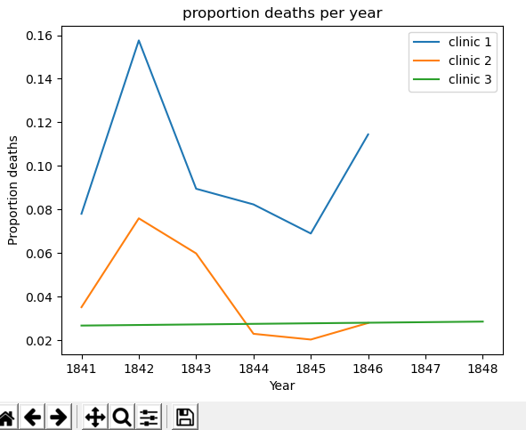

Slide 3
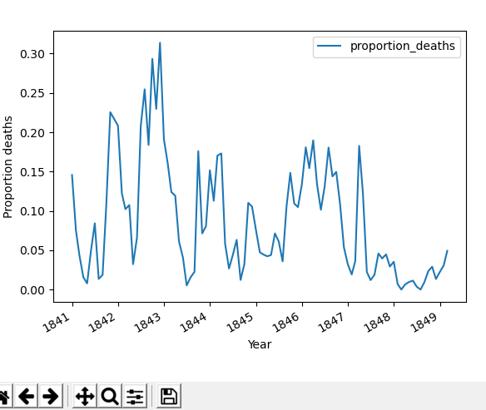

Slide 4
